Slide 1
Block Chain
Anuradha Ravi
CCC628

Slide 2
Some Trivia
Google Announces Google Assistant with Smart Displays

Slide 3
What is a Block Chain?
A New revolution in the world of Trust and Privacy
What is the underlying principle?
Distributed Database/Distributed ledger management
P2P (Peer to Peer Network)
Why do we need Block Chain?
To eliminated third party involvement
To overcome single point of failure
To distribute tasks among different resources

Slide 4
What is a Block?
Components
Block Header
Hash of previous block
Timestamp
Any other fields that are required.
Transactions
Data
Hash
A chain is formulated by adding new block to the already existing chain.
A new block with many transactions/data can be added, but it needs verification.

Slide 5
Variants of Block Chain
Proof of work
Proof of stake
Proof of elapsed time
Smart Contracts
Private Block Chains
HyperLedger
Block Chains for IoT
Some UseCases
Goelm
Sparc
SONM

Slide 6
Block Chain System
Networked Peer to Peer Write once and read only database systems
Network Immutability

Slide 7



Consensus Algorithm
Proof of Work
Proof of Stake
Delegated Proof of Stake
Nxt:
Byzantine Fault Tolerant Algorithm

Slide 8
Issues related to POW and POS
POW
Huge computation involvement.
POS
Security as multiple branches can be created to perform mining.

Slide 9
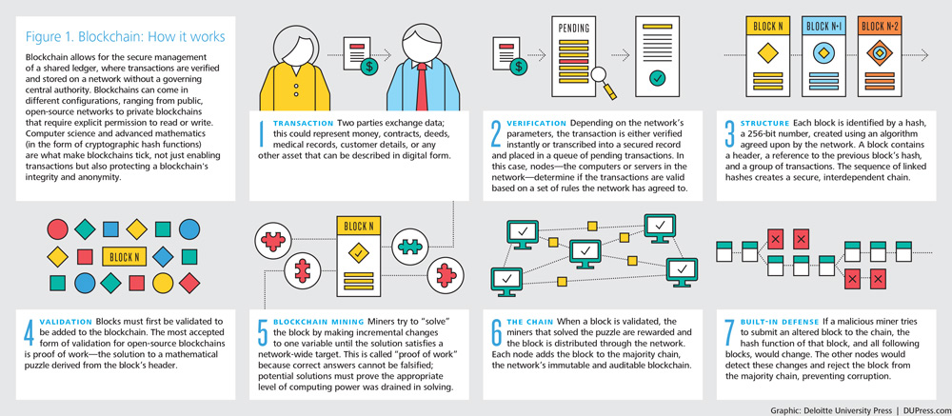
A Summary

Slide 10
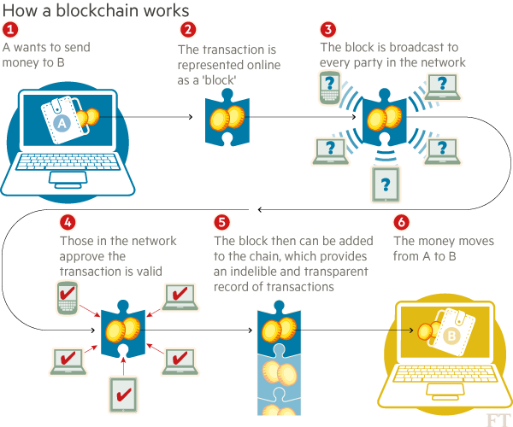

Slide 11
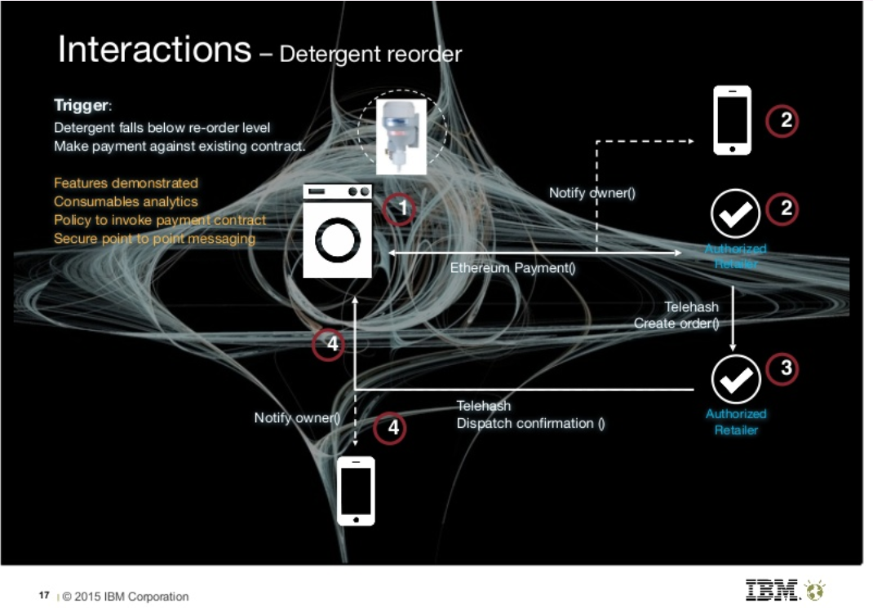
CASE STUDY – Using Smart Contracts

Slide 12
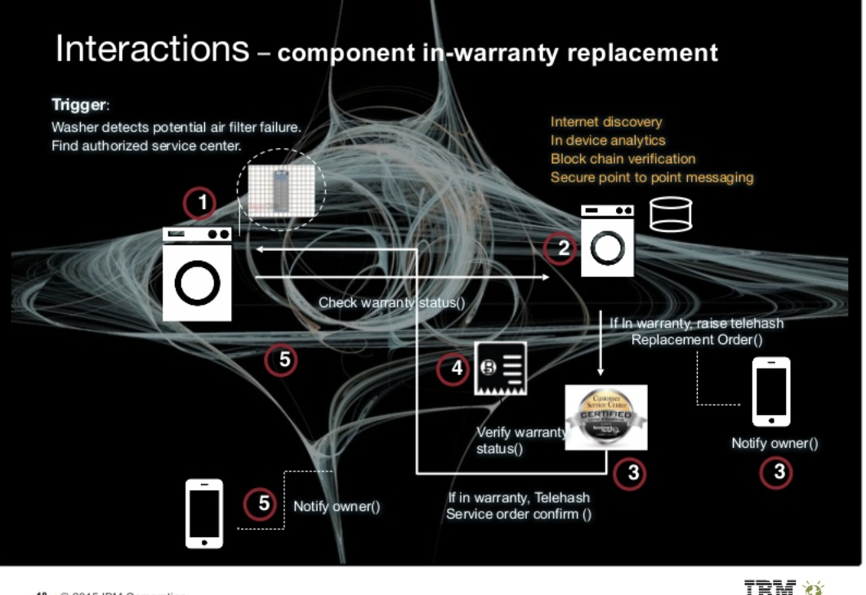

Slide 13
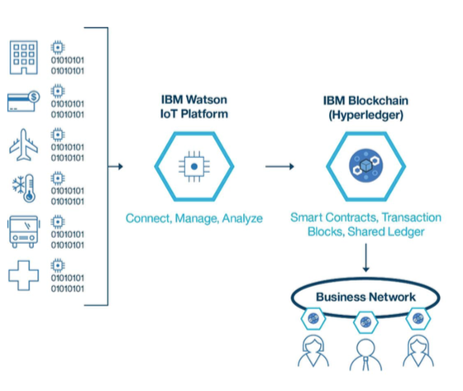
IBM Watson IBM Blockchain

